Slide 1
Feature engineering for credit card fraud
Chris Kuo, Ph.D.| Columbia University

Slide 2
What kind of fraud happening in credit card?
Credit card fraud happens basically in two types:
Application fraud: similar to identity fraud that one person uses another person's personal data to obtain a new card.
Transaction fraud: When a card is stolen or a lost card is obtained to conduct fraudulent transactions.
Do you know?
The total credit card outstanding loans in U.S. is about $2.4 trillion dollars per year.
A 10% fraudulent rate result in a loss of $240 billion dollars.

Slide 3
Strategy to detect fraud -- Aggregation
A fraudster will try to abuse the card as much as possible in a short period of time before the card is detected and suspended. So we should see abnormal transactions in a short period of time.
With this goal, if we aggregate transactions over a period of time, we shall be able to discover abrupt changes.

Slide 4
A hypothetical example
Can you find any abnormal transactions in this example?
Merchant id | Merchant category code | Merchant city | Merchant state | Time | Transaction method | Tnx type | Amt
K2203 | BC | BOS | MA | 9:02 | Magnetic | Retail | $100.1
L3425 | GD | NYC | NY | 9:10 | Magnetic | Retail | $40.1
F3928 | VS | NYC | NY | 10:20 | Chip | Retail | $5.1
W9843 | TY | POR | ME | 13:20 | Magnetic | Internet | $200

Slide 5
Feature engineering through aggregation
Aggregation by time:
Average or maximum amounts spent per transaction in the past one week, or XX weeks
Average or maximum amounts spent per day in the past one week, or XX weeks,
Average or maximum amounts by merchant category in the past one week, or XX weeks,

Slide 6
Feature engineering through aggregation
Aggregation by merchant category code:
Average amount per day spent over a 30 day period on all transactions up to this one on the same merchant type as this transaction
Total number of transactions with same merchant during past 30 days
Average amount spent over the course of 1 week during the past 3 months on same merchant type as this transaction

Slide 7
Feature engineering through aggregation
Aggregation by merchant location and time:
Number of retail locations per day and the duration between the locations in the past one week, or XX weeks,
Minimum number of minutes between transactions of two retail locations in the past one week, or XX weeks,

Slide 8
Feature engineering through aggregation
Aggregation by transaction method:
Transactions by magnetic stripe are prone to fraudulent than chip or PIN transactions. So we can create aggregated amount by transaction type per card. Average amount by transaction method per day in the past one week, or XX weeks,
Number of transactions by transaction method per day in the past one week, or XX weeks

Slide 9
Why do we peer-review work by other researchers?
“Data mining for credit card fraud: A comparative study”
# | Feature
1 | Average amount spent per transaction over a month on all transactions
2 | Average amount spent over the course of 1 week during past 3 months
3 | Average amount spent per day over the past 30 days
4 | Average amount per day spent over a 30 day period on all transactions up to this one on the same merchant type as this transaction
5 | Total number of transactions with same merchant during past 30 days
6 | Average amount spent over the course of 1 week during the past 3 months on same merchant type as this transaction
7 | Total amount spent on the same day up to this transaction
8 | Total number of transactions on the same day up to this transaction
9 | Average amount per day spent over a 30 day period on all transactions up to this one on the same merchant as this transaction

Slide 10
Why do we peer-review work by other researchers?
# | Feature
9 | Average amount per day spent over a 30 day period on all transactions up to this one on the same merchant as this transaction
10 | Total number of transactions with the same merchant during last month
11 | Average amount per day spent over a 30 day period on all transactions up to this one on the same currency type as this transaction
12 | Total number of transactions in the same currency during the past 30 days
13 | Average amount spent over a 30 day period on all transactions up to this one on the same country as this transaction
14 | Total number of transactions in the same country during the past 30 days before this transaction
15 | Average amount spent over the course of 1 week during the past 3 months on same merchant as this transaction
16 | Total number of transactions with the same merchant during the past 3 months

Slide 11
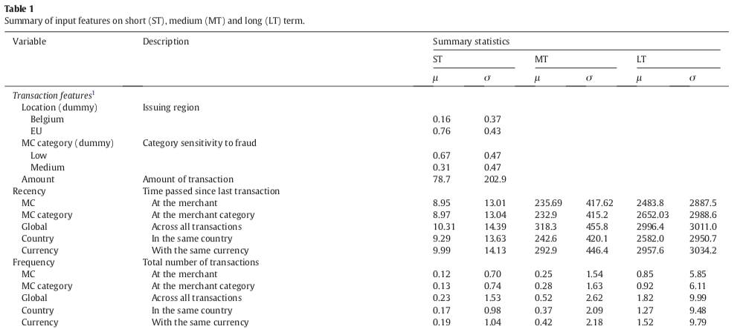
Recency
Frequency

Slide 12
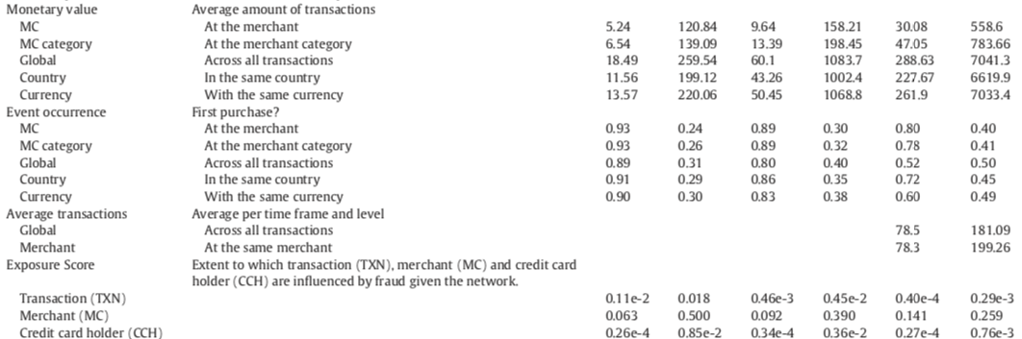
APATE: A novel approach for automated credit card transaction fraud detection using network-based extensions
Monetary

Slide 13
Why do we peer-review work by other researchers?
It will be beneficial to observe feature engineering strategies proposed by other researchers.
Whitrow et al. (2009) describe in great length how they have derived data attributes through aggregation.
Bhattacharyya et al. (2010) report data attributes including primary attributes and derived attributes.
Bahnsen et al. (2016) expand the transaction aggregation strategy, and create features based on the periodic behavior of the time of a transaction using the von Mises distribution. These studies then apply supervised learning techniques: support vector machines (SVM) and random forests (RF) etc. in detecting credit card fraud.
Sundarkumar & Ravi (2015) list the data attributes in their banking and insurance fraud detection application.
Vlasselaer et al. (2017) develop their network-based features by examining the network of credit card holders and merchants and deriving a time-dependent suspiciousness score for each network object.

Slide 14
Work cited
S. Bhattacharyya, S. Jha, K. Tharakunnel, J. Westland, Data mining for credit card fraud: a comparative study, Decision Support Systems 50 (3) (2011) 602–613.
A. C. Bahnsen, D. Aouada, A. Stojanovic, B. Ottersten, Feature engineering strategies for credit card fraud detection, Expert Systems With Applications 51 (2016) 134–142.
G. G. Sundarkumar and V. Ravi, “A novel hybrid undersampling method for mining unbalanced datasets in banking and insurance,” Engineering Applications of Artificial Intelligence, vol. 37, pp. 368–377, 2015.
C. Whitrow, D.J. Hand, P. Juszczak, D. Weston, N.M. Adams, Transaction aggregation as a strategy for credit card fraud detection, Data Mining and Knowledge Discovery 18 (1) (2009) 30–55.
V. Van Vlasselaer, C. Bravo, O. Caelen, T. Eliassi-Rad, L. Akoglu, M. Snoeck, and B. Baesens, “Apate: A novel approach for automated credit card transaction fraud detection using network-based extensions,” Decision Support Systems, vol. 75, pp. 38–48, 2015

